Slide 1

Environmental sound classification ESC-50
Universitá degli studi di Padova
MS Data Science, Human data analytics
Jose Sebastian Rojas Ardila
Andres Aranguren

Slide 2
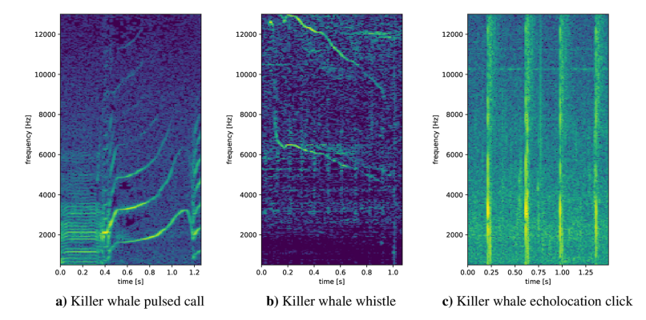
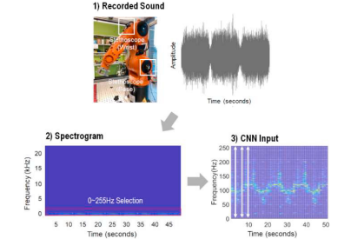
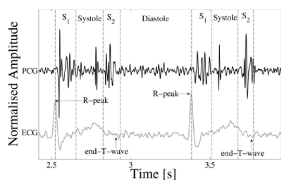
Introduction
Biological Applications
Medical Applications
Predictive Maintenance

Slide 3
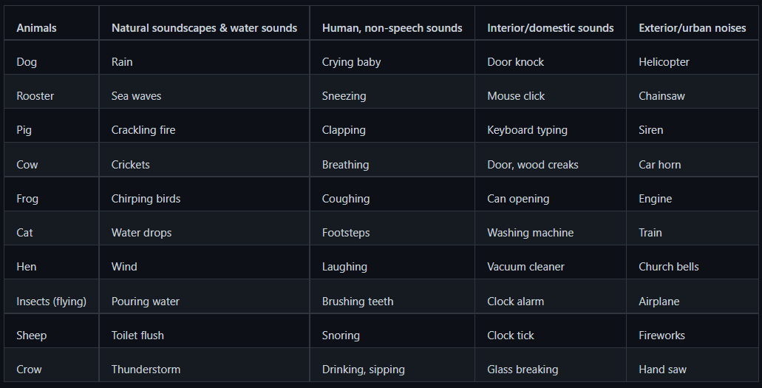
Dataset overview ESC-50
Dataset is a labeled collection of 2000 environmental audio recordings.
5 major categories
5 second long recordings
50 semantical classes

Slide 4
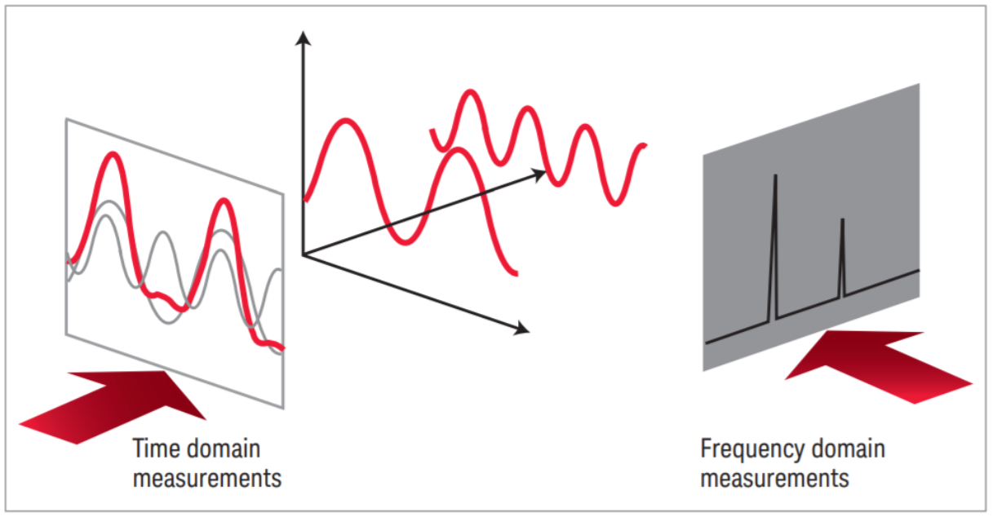
Processing
Time domain and frequency domain processing.
Our Aim is compared different models based on the approach

Slide 5
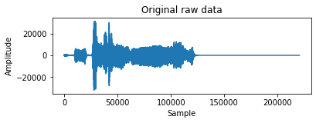
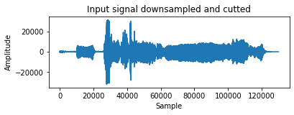
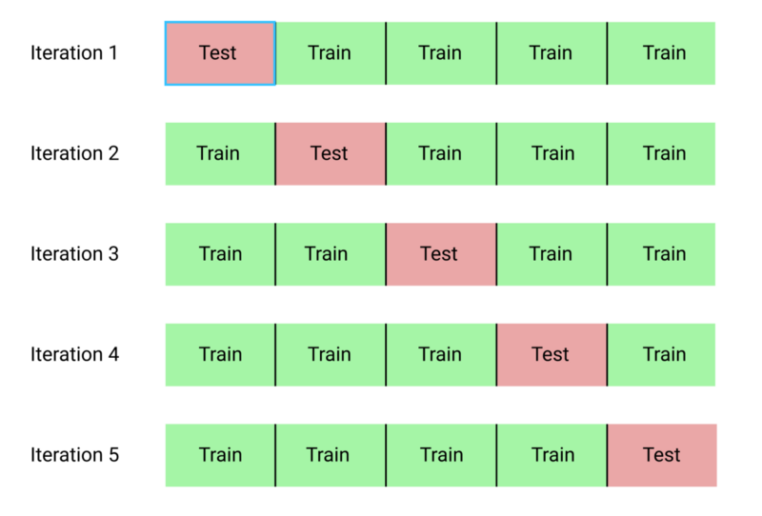
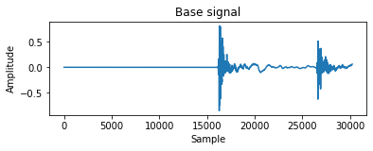
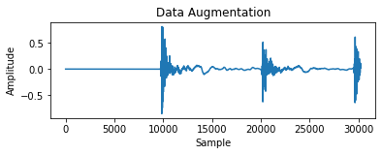
Time domain
Remove not valuable information
2. 5 folds
400 samples equally distributed
10 signals of the same class, then each fold will have 4000 signals
3. Data augmentation, production of input signal

Slide 6
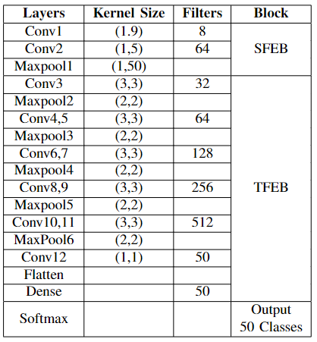
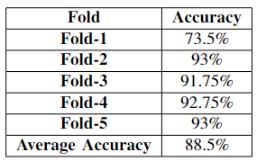
ACDNet Model
Kullback-Leibler Divergence Loss
1000 Epochs

Slide 7
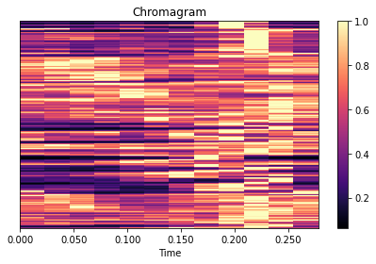
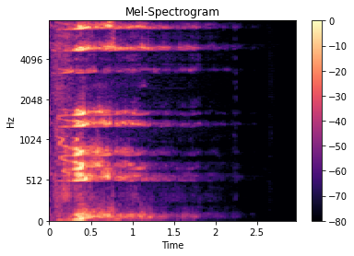
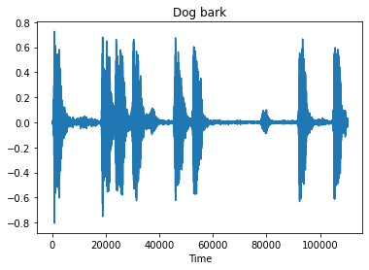
Frequency domain
Short time fourier transform (STFT)
Extracted audio features :
mel-spectrogram
Chromagram
Spectral contrast
Tonnetz

Slide 8
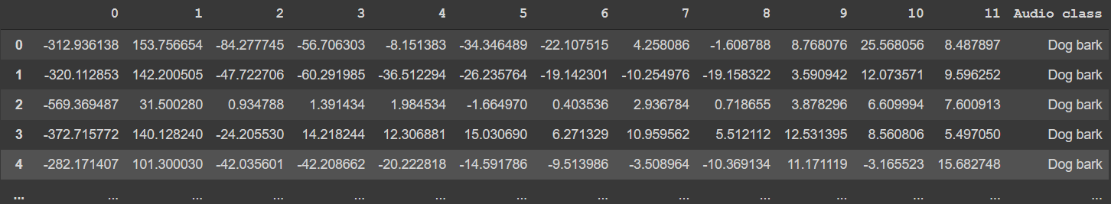

Data used as model input
Model
Prediction

Slide 9
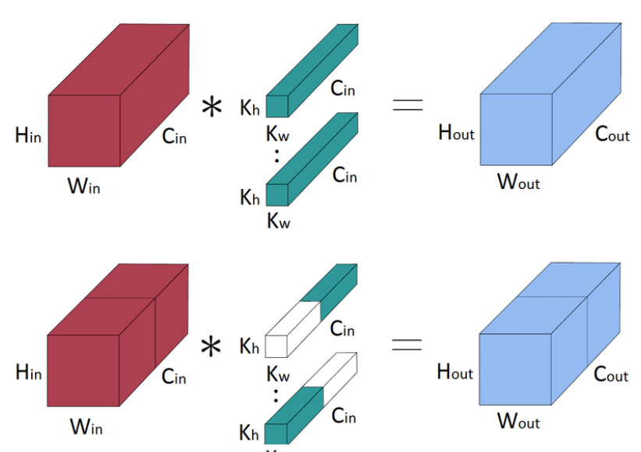
Model
Grouped CNN
Reduce the computational cost of training wide deep networks.
Each filter convolves only on some of the feature map obtained in previous layers.
Reduces the number of operations to obtain the final feature map.

Slide 10
Model comparison performance
ESC-50
Model | Accuracy
ACDNet | 88.50%
CNN Grouped | 82.40%
Human | 81.30%

Slide 11
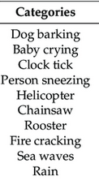
Reduced dataset ESC-10
Reduces ambiguity between classes
Percussive sounds with clear temporal patterns (Dog barking, clock ticking)
Sound with strong harmonic content (crying baby)
Structured noise (rain,)

Slide 12
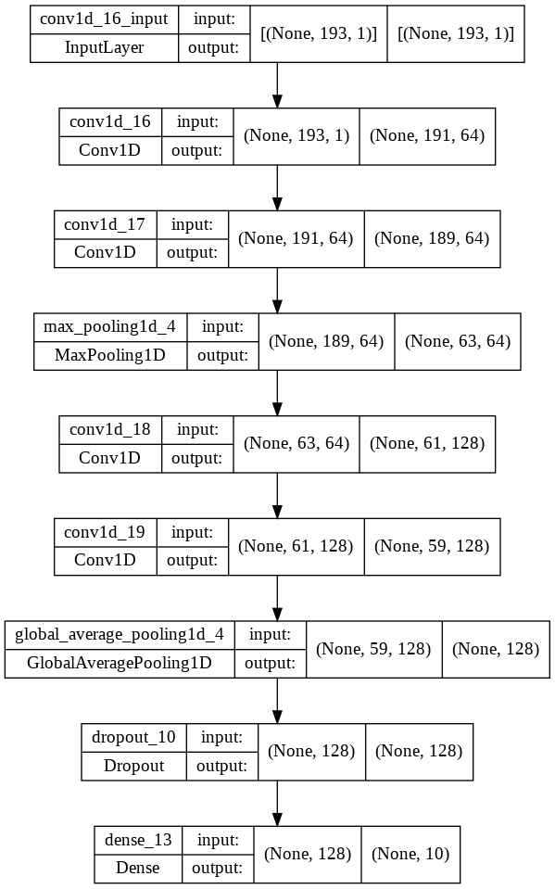
Models implemented for ESC-10
SVM
Random Forest
Naive Bayes
CNN (RMSprop , Adam)
Multilayer perceptron

Slide 13
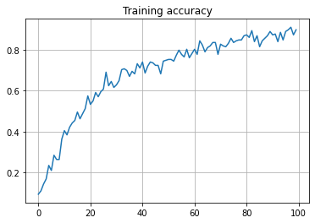
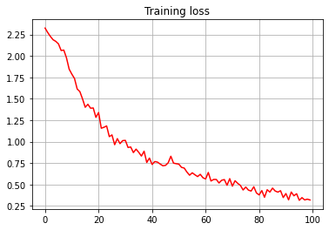
Results ESC-10
CNN (RMSprop)

Slide 14
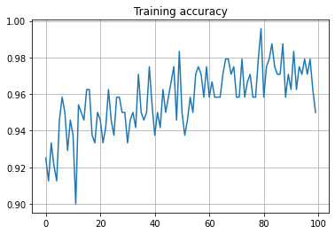
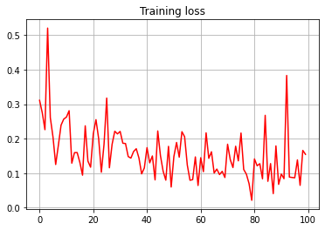
Multilayer perceptron

Slide 15
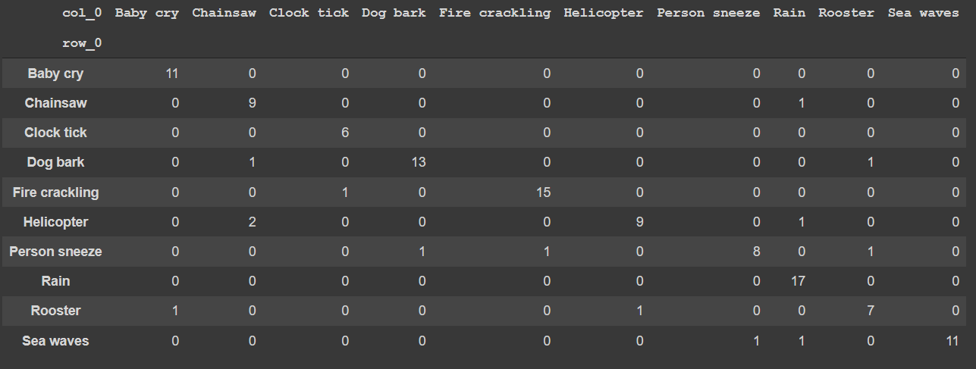
Random forest

Slide 16

Random forest best performance
Model complexity reduction
Running time reduction

